Slide 1
CELLS
The Similarities
and
Differences of
Animal and Plant Cells
For free Science videos for kids .......visit www.makemegenius.com

Slide 2
Cells
Cells are the basic units of function in all living things.
Cells in animals and plants have unique forms that allow each to take part in processes that are necessary for the cell and or/living thing to survive.
For free Science videos for kids .......visit www.makemegenius.com

Slide 3
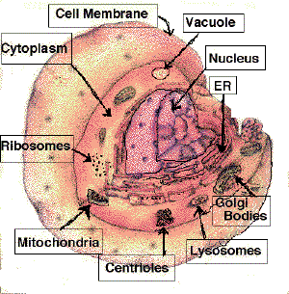
Look at This
Different parts of a Cell
For free Science videos for kids .......visit www.makemegenius.com

Slide 4
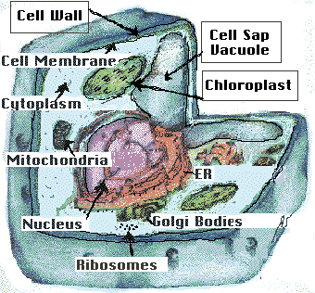
Plant Cell
For free Science videos for kids .......visit www.makemegenius.com

Slide 5


Animal cell
For free Science videos for kids .......visit www.makemegenius.com

Slide 6
What is an organelle?
Organelles are to cells what organs are to the body.
They carry out the individual tasks of gaining and working with energy, as well as directing the overall behavior of the cells.
Let’s familiarize yourself with the organelles of the animal and plant cell.
For free Science videos for kids .......visit www.makemegenius.com

Slide 7
Organelles : Function :
Nucleus: Contains the DNA and RNA and manufactures proteins
Nucleolus: In nuclei where ribosomes are synthesized.
Nuclear Envelope: Membrane of lipids and proteins that surrounds nucleus
Centrioles: structure that appears during mitosis(cell division)
Mitochondria: Energy producers of the cell
Ribosomes: Produce proteins
For free Science videos for kids .......visit www.makemegenius.com
More Organelles

Slide 8
Organelles Function
Golgi Bodies: Packages Proteins
Chloroplasts: Involved in photosynthesis
Vacuoles: Store waste, nutrients, and water
Lysosome: Contains digestive enzymes, mostly in animal cells
Endoplasmic Reticulum: Passageway that transports proteins from the nucleus
Rough ER are covered in ribosomes, Smooth ER is not!
For free Science videos for kids .......visit www.makemegenius.com

Slide 9
While not exactly organelles, the following are also important parts of the cells:
Cell membrane: Semi-permeable lining that surrounds the cell
Cell Wall: Is a stiff non-living wall that surrounds the cell membrane made of cellulose
Cytoplasm: Jelly-like material surrounding the organelles
For free Science videos for kids .......visit www.makemegenius.com

Slide 10
There are a few important processes in which the plant and animal cell engages:
Diffusion: How food, air, and water gets in and out of the cell.
Cellular Respiration: How an animal cell gets energy.
Photosynthesis: How a plant cell gets energy.
For free Science videos for kids .......visit www.makemegenius.com

Slide 11
Animal and Plant cells have many similarities. Can you write the organelles and cell parts they both have in common.
For free Science videos for kids .......visit www.makemegenius.com

Slide 12
Similarities
Both contain:
Nucleus, Nuclear Envelope, Chromosomes- which carry the genes or the DNA.
Cytoplasm
Mitochondria
Cell membranes
For free Science videos for kids .......visit www.makemegenius.com

Slide 13
Differences
Plant cells have non-living rigid cell walls.
Plant cells contain chloroplasts which contain chlorophyll, a green chemical needed for photosynthesis.
Plant cells contain a large vacuole; animal cells never contain large vacuoles.
Plant cells are regular in shape; animal cells are irregular in shape.
For free Science videos for kids .......visit www.makemegenius.com

